Slide 1
Thenuka dulkith sachindu ruwanath pulitha dinsara vishwa prabashwara
sjc

Slide 2
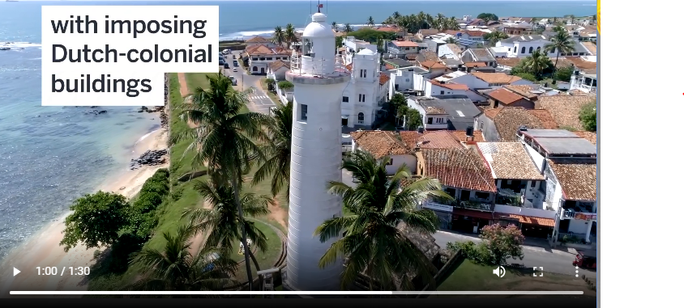
Protect our beach

Slide 3
We can use recycle bins for each beaches.
These days our beaches are ruined by garbage

Slide 4
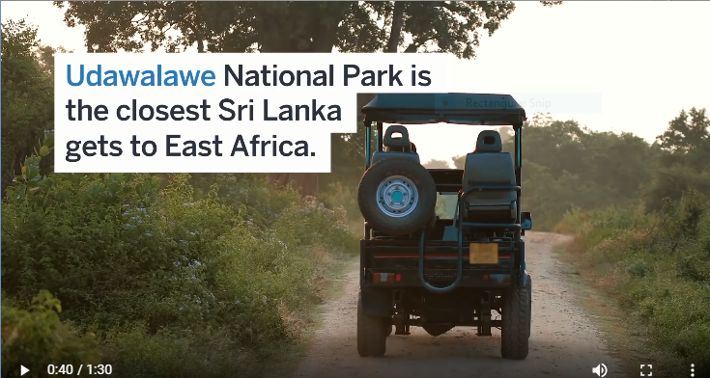
We have very natural rain forests .we have to protect it,
We can plant new trees

Slide 5
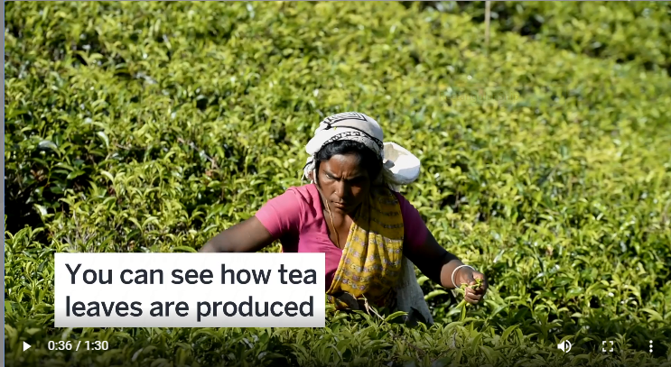
We can provide tea industry. We can give world’s best tea products from using new technology with new machines and factories.

Slide 6
We can develop the hotel industry

Slide 7
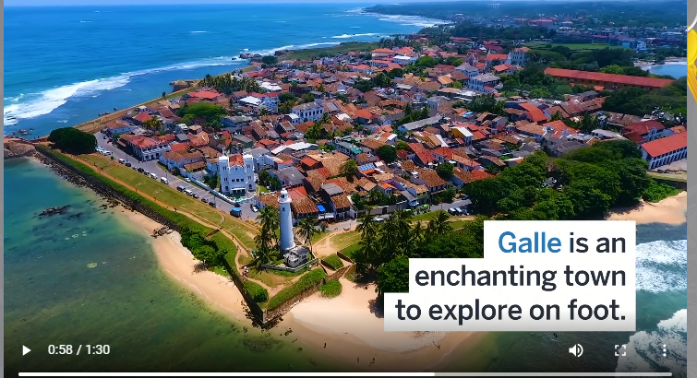
We can build hotels with high facilities and give more services better than now.

Slide 8
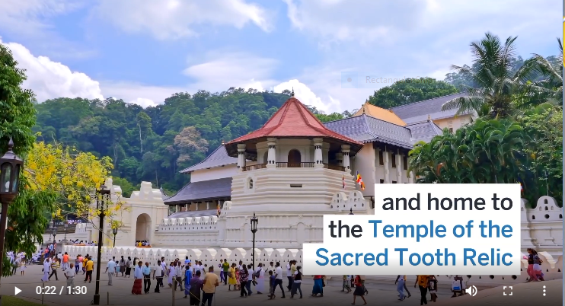
Popularize our cultural events
We can use social media platforms for popularize our cultural events like
Kandy perahara,New year festival and Vesak festival.

